Slide 1
DATA STRUCTURE
Soumi Dutta, IEM

Slide 2
DATA STRUCTURE
Data structure is a particular way of storing and organizing data in a computer so that it can be used efficiently.
An abstract data type (ADT) is a mathematical model for a certain class of data structures that have similar behavior; or for certain data types of one or more programming languages that have similar semantics. An abstract data type is defined indirectly, only by the operations that may be performed on it and by mathematical constraints on the effects (and possibly cost) of those operations.

Slide 3
DATA STRUCTURE
Linear Data Structure:
Linear data structure is linear if element is adjacent to each other. It has exactly two neighbors elements to which it is connected as its previous and next member.
Example of Linear Data Structure
Array, Stack , Queue, Linked List
Non- Linear Data Structure
Non-Linear data structure is that if one element can be connected to more than two adjacent element then it is known as non-linear data structure.
Example of Linear Data Structure:
Tree , Graph

Slide 4
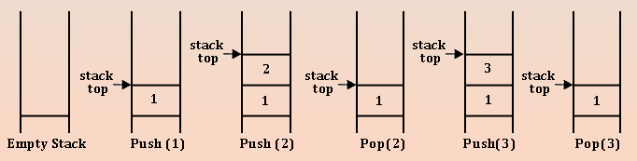
DIFFERENT TYPES OF ADT
Stack (LIFO): Stack follows the rule of last in first out rule. Mainly two action are performed by stack one is push and other is pop. The last thing which we placed or push on stack is the first thing we can get when we pop. A stack is a list of element with insertion and deletion at one end only.

Slide 5
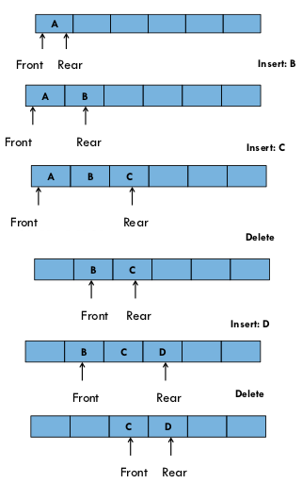
DIFFERENT TYPES OF ADT
Queue (FIFO)
A queue is an ordered list in which all insertions take place at one end, the rear while all deletions take place at the other end, the front.

Slide 6
DIFFERENT TYPES OF ADT
Linked List
A linked list is a data structure which consists of data record in a sequence such that each data record have a field of data as well as link reference to its connected node. It do not provide the random access to any of its member data as it is form of a indexing and the connected node is pre-defined.
There are mainly three kinds of linked lists:
  Singly linked list
  Doubly linked list
  Circular linked list

Slide 7

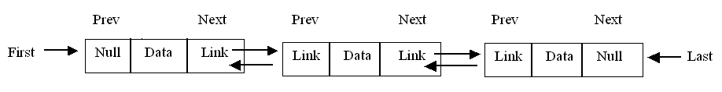
DIFFERENT TYPES OF ADT
Singly link list: In the singly link list each node have two fields one for data and other is for link reference of the next node. The node have null only to the last node of the link field. This can be seen in the following picture.
Doubly link list: In the doubly link list each node have three field two fields for link which is the reference to next and previous and one for data record. The node have null only to the first node of previous and last node at the next. This can be seen in the following picture.

Slide 8
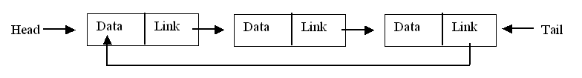
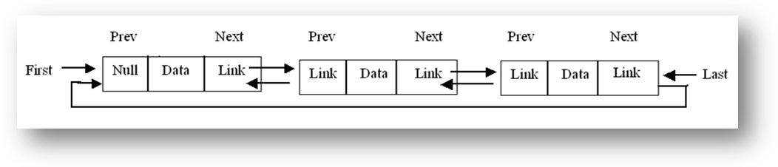
DIFFERENT TYPES OF ADT
Circular link list: If talking about singly circular link list each node have two fields one for data record and other for link reference to the next node. The last node has link reference to the first node. There in no null present in the link of any node.

Slide 9
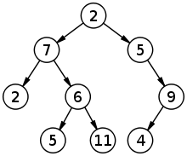
DIFFERENT TYPES OF ADT
Tree Structure:
A tree data structure that are based on hierarchical tree structure with sets of nodes. A tree is a acyclic connected graph with zero or more children nodes and at most one parent nodes.

Slide 10
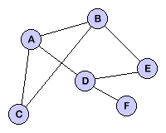
DIFFERENT TYPES OF ADT
Graph Structure:
A graph is a collection of nodes and edges without hierarchy and parent child relationship.

Slide 11
ALGORITHM
A list of step by approaches to solve any problem.
Two measure factors of efficiency of an algorithm :
  Space
  Time
Space complexity:
Analysis of space complexity of an algorithm or program is the amount of memory it needs to run to completion.
Time complexity:
The time complexity of an algorithm or a program is the amount of time it needs to run to completion.

Slide 12
ANALYZE AN ALGORITHM
When we analyze an algorithm it depends on the input data, there are three cases :
  Best case: In the best case, the amount of time a program might be expected to take on best possible input data.
  Average case: In the average case, the amount of time a program might be expected to take on typical (or average) input data.
  Worst case: In the worst case, the amount of time a program would take on the worst possible input configuration.

Slide 13
ASYMPTOTIC NOTATION
BIG “OH” NOTATION:
Big Oh is a characteristic scheme that measures properties of algorithm complexity performance and/or memory requirements.
The algorithm complexity can be determined by eliminating constant factors in the analysis of the algorithm. Clearly, the complexity function f(n) of an algorithm increases as ‘n’ increases.
Example: O(n), O(logn)

Slide 14


EXAMPLE BUBBLE SORT
First Iteration:
25 | 17 | 31 | 13 | 2
17 | 25 | 31 | 13 | 2
No of Loops=4
No of elements=5
17 | 25 | 31 | 13 | 2
17 | 25 | 13 | 31 | 2
17 | 25 | 13 | 2
31

Slide 15

EXAMPLE BUBBLE SORT
Second Iteration:
17 | 25 | 13 | 2
31
17 | 25 | 13 | 2
31
No of Loops=3
No of elements=5
17 | 13 | 25 | 2
31
17 | 13 | 2
25 | 31

Slide 16

EXAMPLE BUBBLE SORT
Third Iteration:
17 | 13 | 2
25 | 31
13 | 17 | 2
25 | 31
No of Loops=2
No of elements=5
13 | 2
17 | 25 | 31

Slide 17

EXAMPLE BUBBLE SORT
Forth Iteration:
13 | 2
17 | 25 | 31
No of Loops=1
No of elements=5
2 | 13 | 17 | 25 | 31
Total no of loops = 4+3+2+1=10
Complexity of Bubble Sort: (n is no of elements)
Complexity =(n-1)+(n-2)+------+3+2+1
= n(n-1)/2
= (n^2)/2 –n/2
= O(n^2) // Maximum Power of n

Slide 18


HOW TO WRITE ALGORITHM
#include<stdio.h>
#include<conio.h>
void main()
{
int i=0;
clrscr();
printf("Enter element: \t");
scanf("%d",&i);
if(i<10)
printf("\n i is less”);
else
printf("\n i is more");
for(int j=11;j<=20;j++)
{
printf("New value of j: \t");
printf("%d\n",j);
}
getch();
}
Include header files stdio.h and conio.h.
Start program //start main method
[Initialize] Set i:=0
Input element into i.
If i<10 then print “i is less”
Else print “i is more”
End else.
Repeat steps 8 to 9 for j=11 to 20
Print “new value of j”
Print j
End program

Slide 19


STACK OPERATION (PUSH/INSERTION)
int push(stack[],top, N, item)
{
if(top==N-1)
printf(“Overflow”);
else
{
top++;
stack[top]=item;
}
return;
}
stack[N] and top:=-1 are declared at the starting of the program.
Function push(stack[],top, N, item)
//item is the data to be inserted in the stack
Start
If top=N-1 then print Overflow
Else
Top:=top+1 [increment top]
Stack[top]:=item
End else
Return.
End

Slide 20


STACK OPERATION (POP/DELETION)
int pop(stack[],top)
{
if(top==-1)
printf(“Underflow”);
else
{
item=stack[top];
printf(“Deleted item: %d”,item);
top--;
}
return;
}
stack[N] and top:=-1 are declared at the starting of the program.
Function pop(stack[],top)
Start
If top=-1 then print Underflow
Else
Item:=Stack[top]
Print deleted item.
top:=top-1 [decrement top]
End else
Return.
End

Slide 21


STACK OPERATION (DISPLAY)
void display(stack[],top)
{
if(top==-1)
printf(“Underflow”);
else
{
for(i=top;i<=0;i++)
printf(“%d”,stack[i]);
}
}
stack[N] and top:=-1 are declared at the starting of the program.
Function display(stack[],top)
Start
If top=-1 then print Underflow
Else
Repeat(step 5)for i=top to 0
Print stack[i]
End of for loop
End else
End

